Slide 1
Clothing Image Classification
By: Nirav Sheth

Slide 2
Introduction
In this presentation, I set out to:
Describe the objective
Information on the Model
Results
Next Steps

Slide 3
Objective
Create an image classification model to classify cloths above 90% accuracy
Idea was generated from weekly frustration from folding clothes
Initial research finds:
No Commercial feasible automated folding machine exists
Existing products are to specialized and expensive

Slide 4
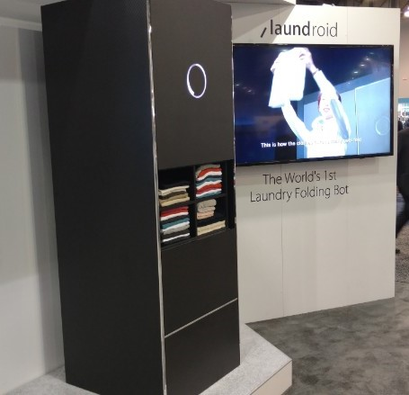
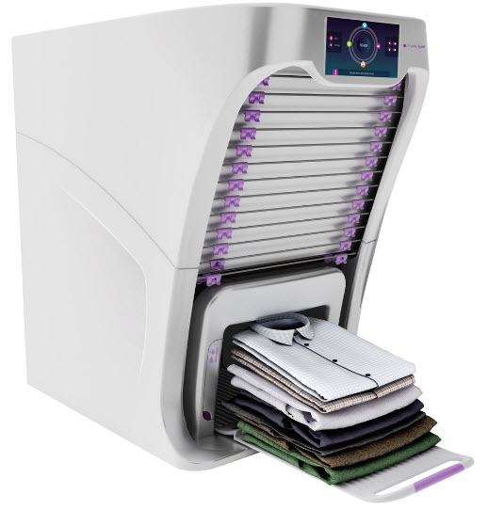
Folding Machines Prototypes
Foldimate: Semi-Automated and priced at $1000. Difficult to use
Laundriod: Fully-Automated and currently priced at $16,000. Current test show that it is slow and difficult to use

Slide 5
Background of Data
Focused on Dress Shirts, Dress Pants, Shorts and T-Shirt
Based on the majority of my closet
Found ~540 Images that are:
Model/Human Free: To specialize the model on clothes coming from the dryer or stack of clothes
Singular Piece of Clothing: To specialize model on the specific clothing types
Variety of Color and Fabrics: To create versatility in the model to recognize different types of clothes

Slide 6
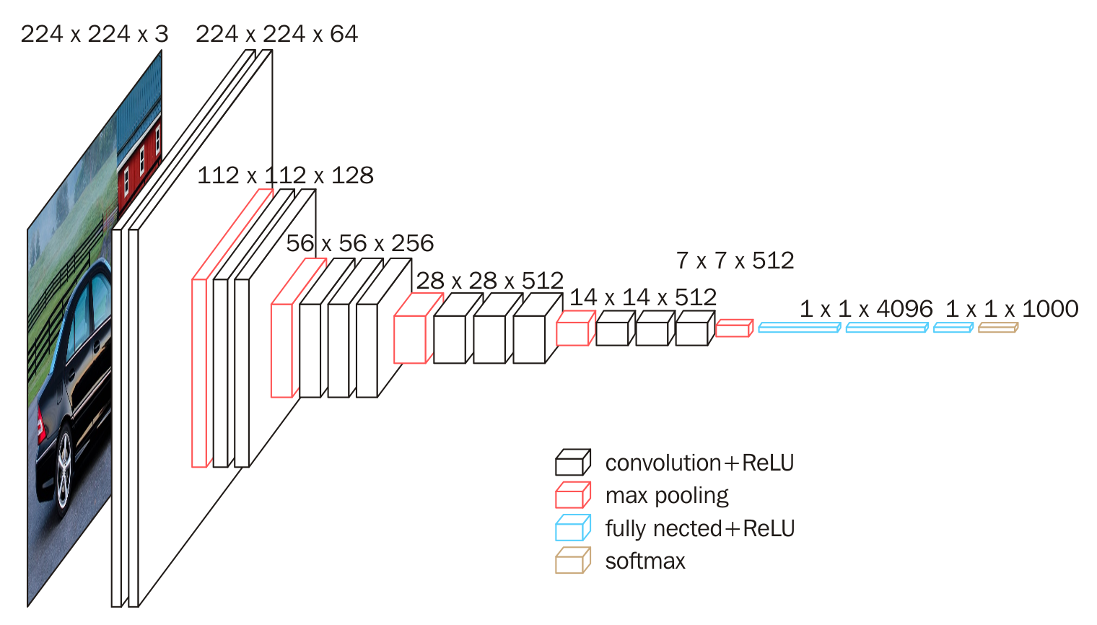
Background on Model
Used a CNN model called VGG16 with ImageNet weights
Can be expanded depended on labelled folders
Currently using 4 different labels, but as label type grow, easy to update model
Takes in any image size and resizes image to 224x 224 to create predicted output

Slide 7
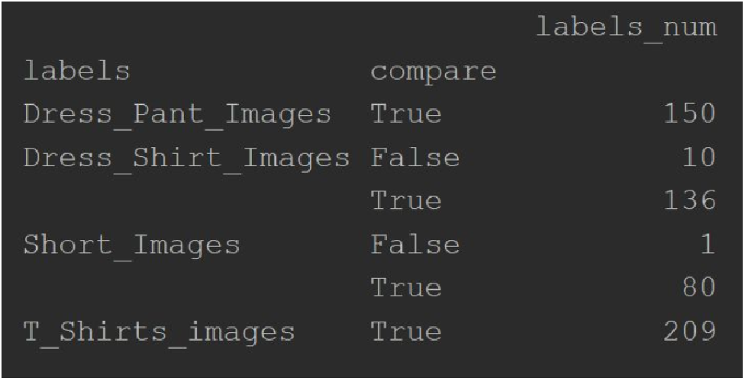
Results
Accuracy: 97.4%
Loss: 0.11
Majority of Errors results from Dress Shirt Images

Slide 8
Next Steps
Continue to expand data set of images that fit criterias
Expand labels to recognize fabrics and additional types of clothing
Research on errors
Implement YOLO which can allow for real time image detection

